Slide 1




DAV FINAL PROJECT
By Anusha Savaram
Net ID: as3444
Email: as3444@rutgers.edu

Slide 2
Consumer Segmentation: Know your customer
‘Customer Segmentation- Know your customer’ is a customer personality Analysis- an attempt to understand the customers, their consumption, spending behavior. We divide the customers into clusters using k-means clustering and study cluster wise behaviors in terms of the commodity the customer is interested in, age, educational background, marital status, number of children at home (if they are teen or kid), are they virtual or in person buyers or are they loyal consumers of fruits, fish, sweet, gold, do they buy on a discount.
This analysis helps businesses in understanding their customers to customize their products, campaign to select targeted customers with certain number of campaigns. This will cut the Advertisement expenditure significantly and channelize the budget as deemed necessary to increase sales.
This is a B2C Business Model. A good understanding of customers is extremely important hence this KYC-Know Your Customer.
Customer Analytics is the most important part of analytics. KYC makes a lot of difference for many countries.

Slide 3
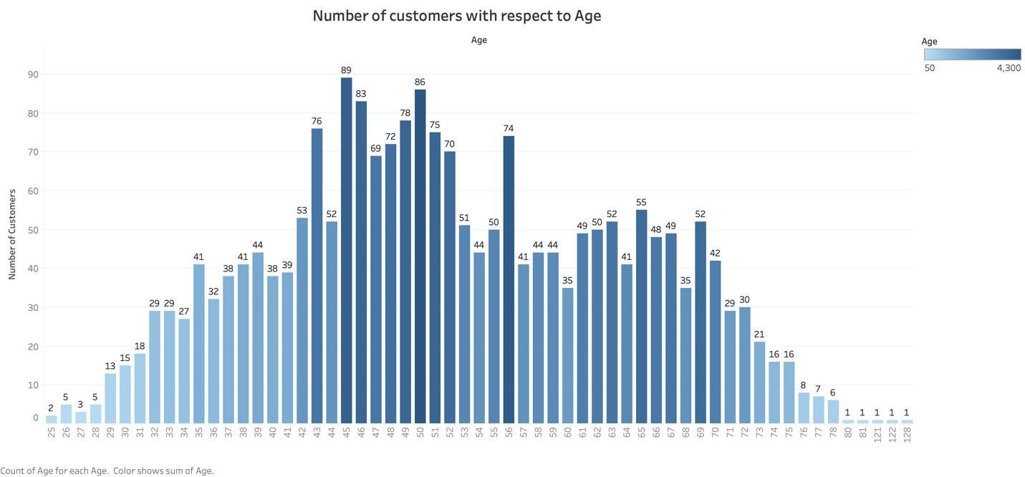
From this chart we analyze that there are more no. of middle age customers who purchased from the company

Slide 4
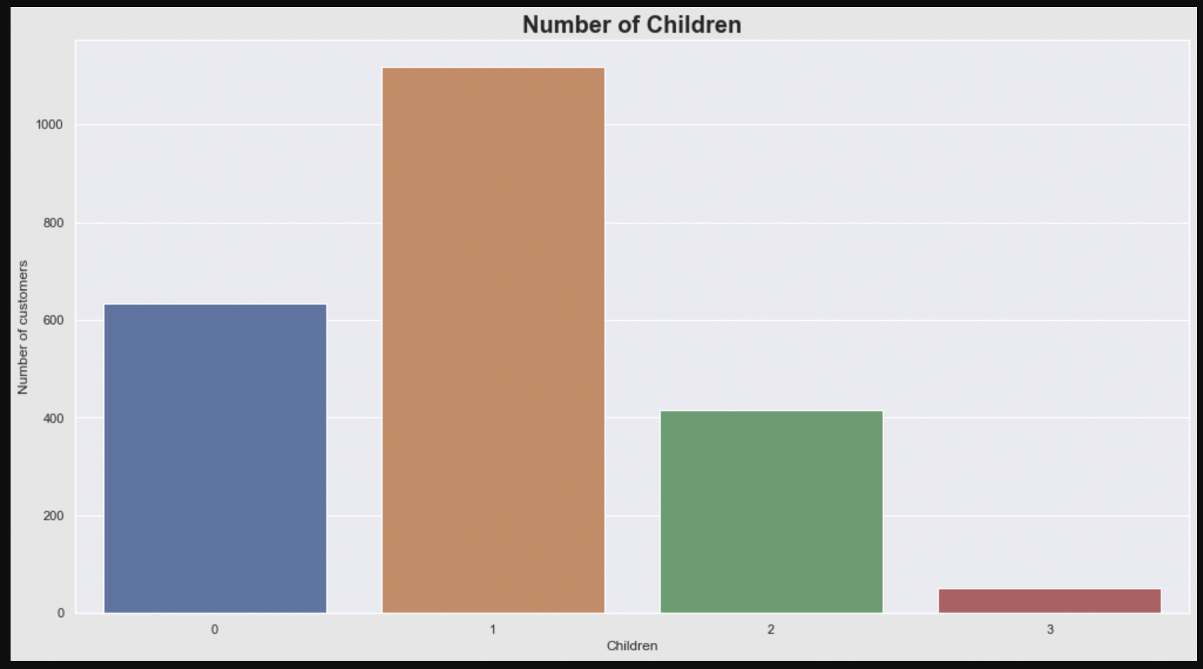
Majority of the customers have single child or no child. Hardly customers have 3 children

Slide 5
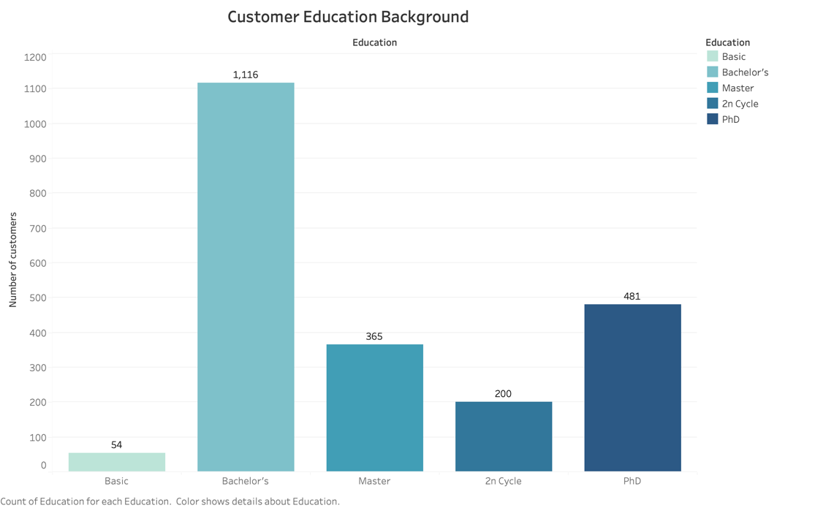
Large number of Customers are with Bachelor’s degree as their highest Qualification who make purchase.

Slide 6
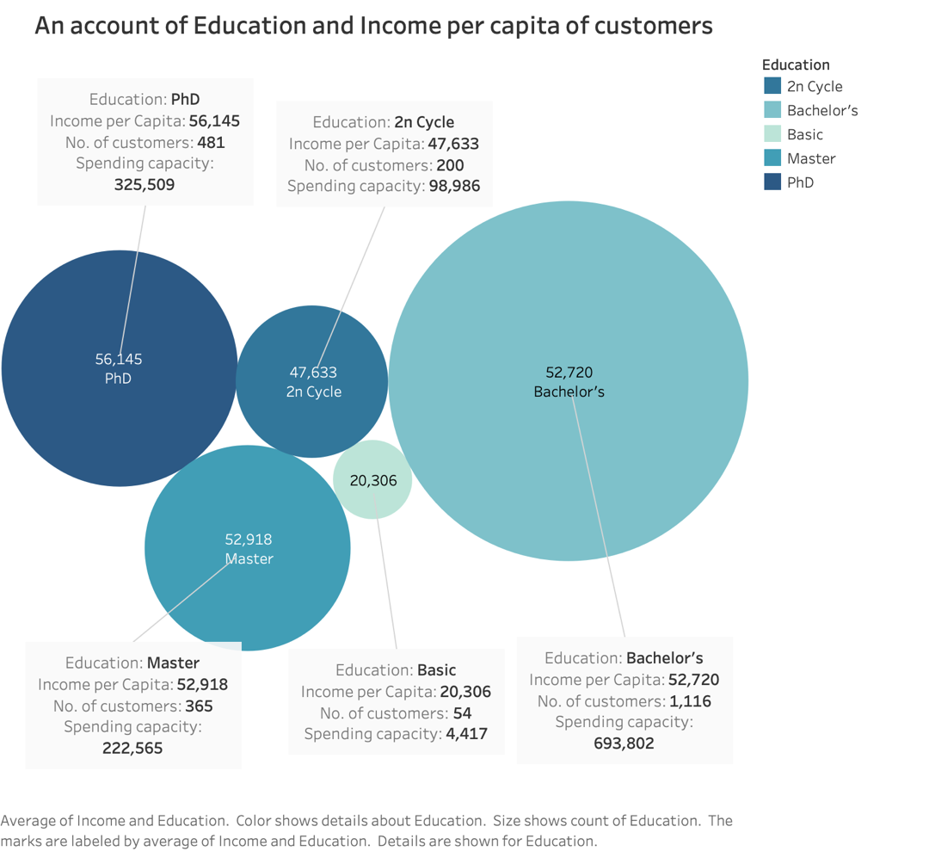
Bachelor’s are spending more despite of relatively less income than PhD and Master’s
The income trend is as expected. Income increases as educational level increases.
Income per capita: Basic<2ncycle<Bachelor’s<Master’s<PhD
Number of customers: Bachelor’s>PhD>Masters’s>2ncycle>Basic. => Progressive society
Spending: Bachelor’s >PhD>>Masters 2ncycle>Basic

Slide 7
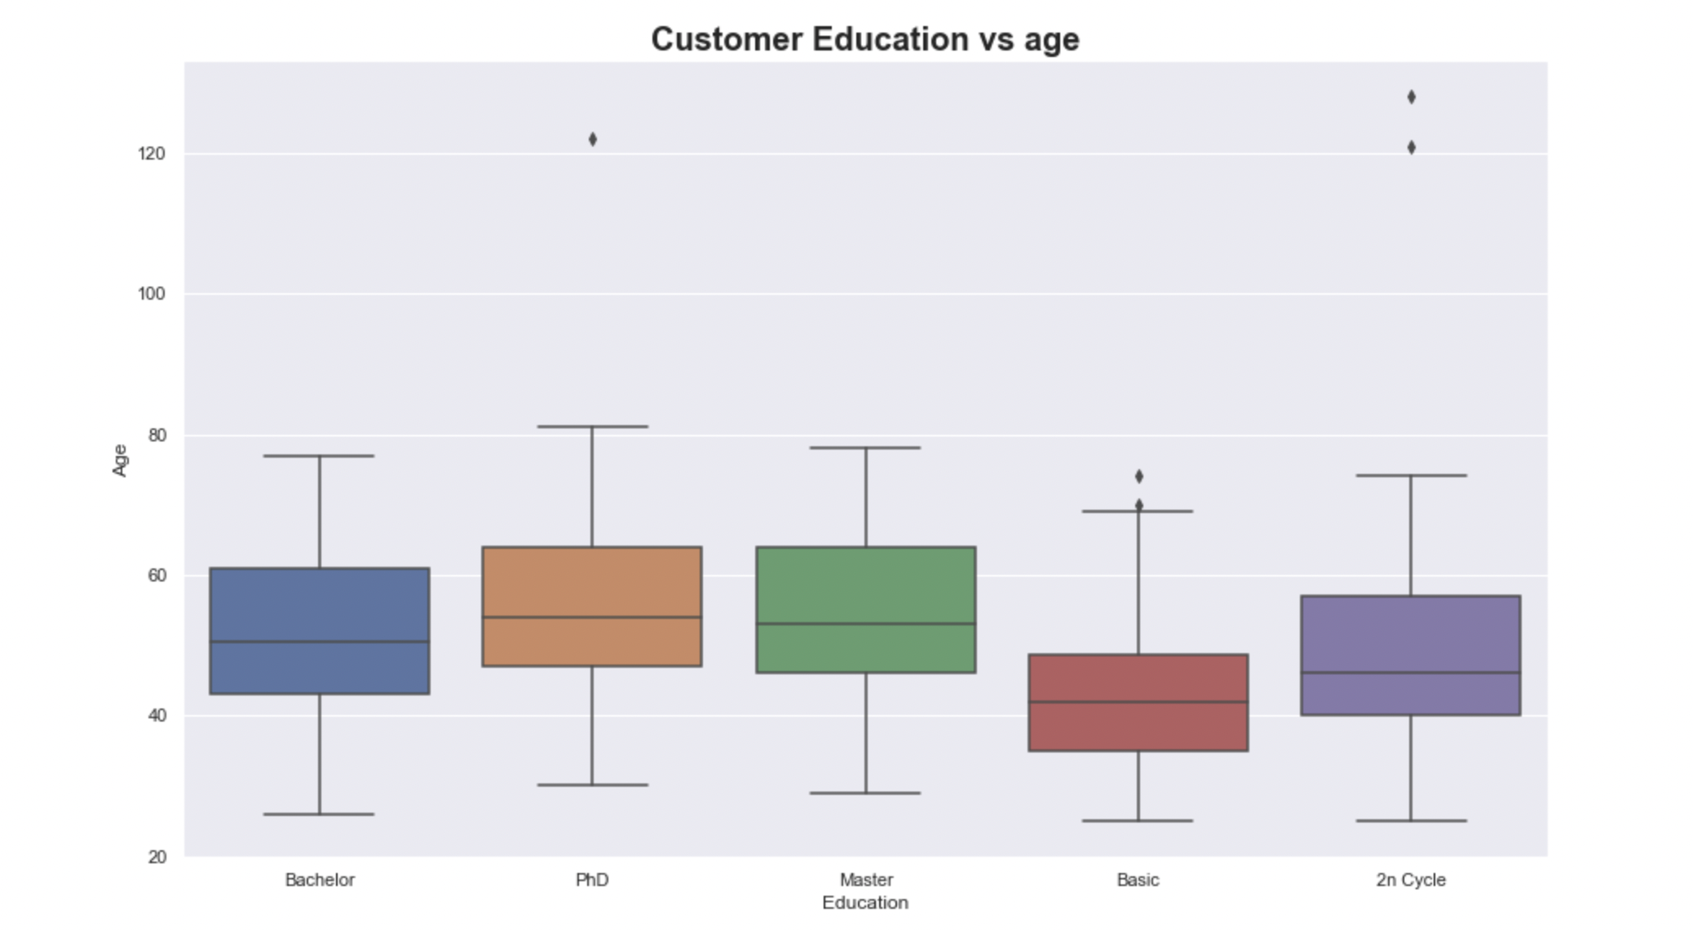
There are few outliers for PHD and 2n Cycle. Majority of the customers have graduation, phD, Master’s background. They are aged around 50 years. Customers with basic educational background are one of the youngest ones.

Slide 8
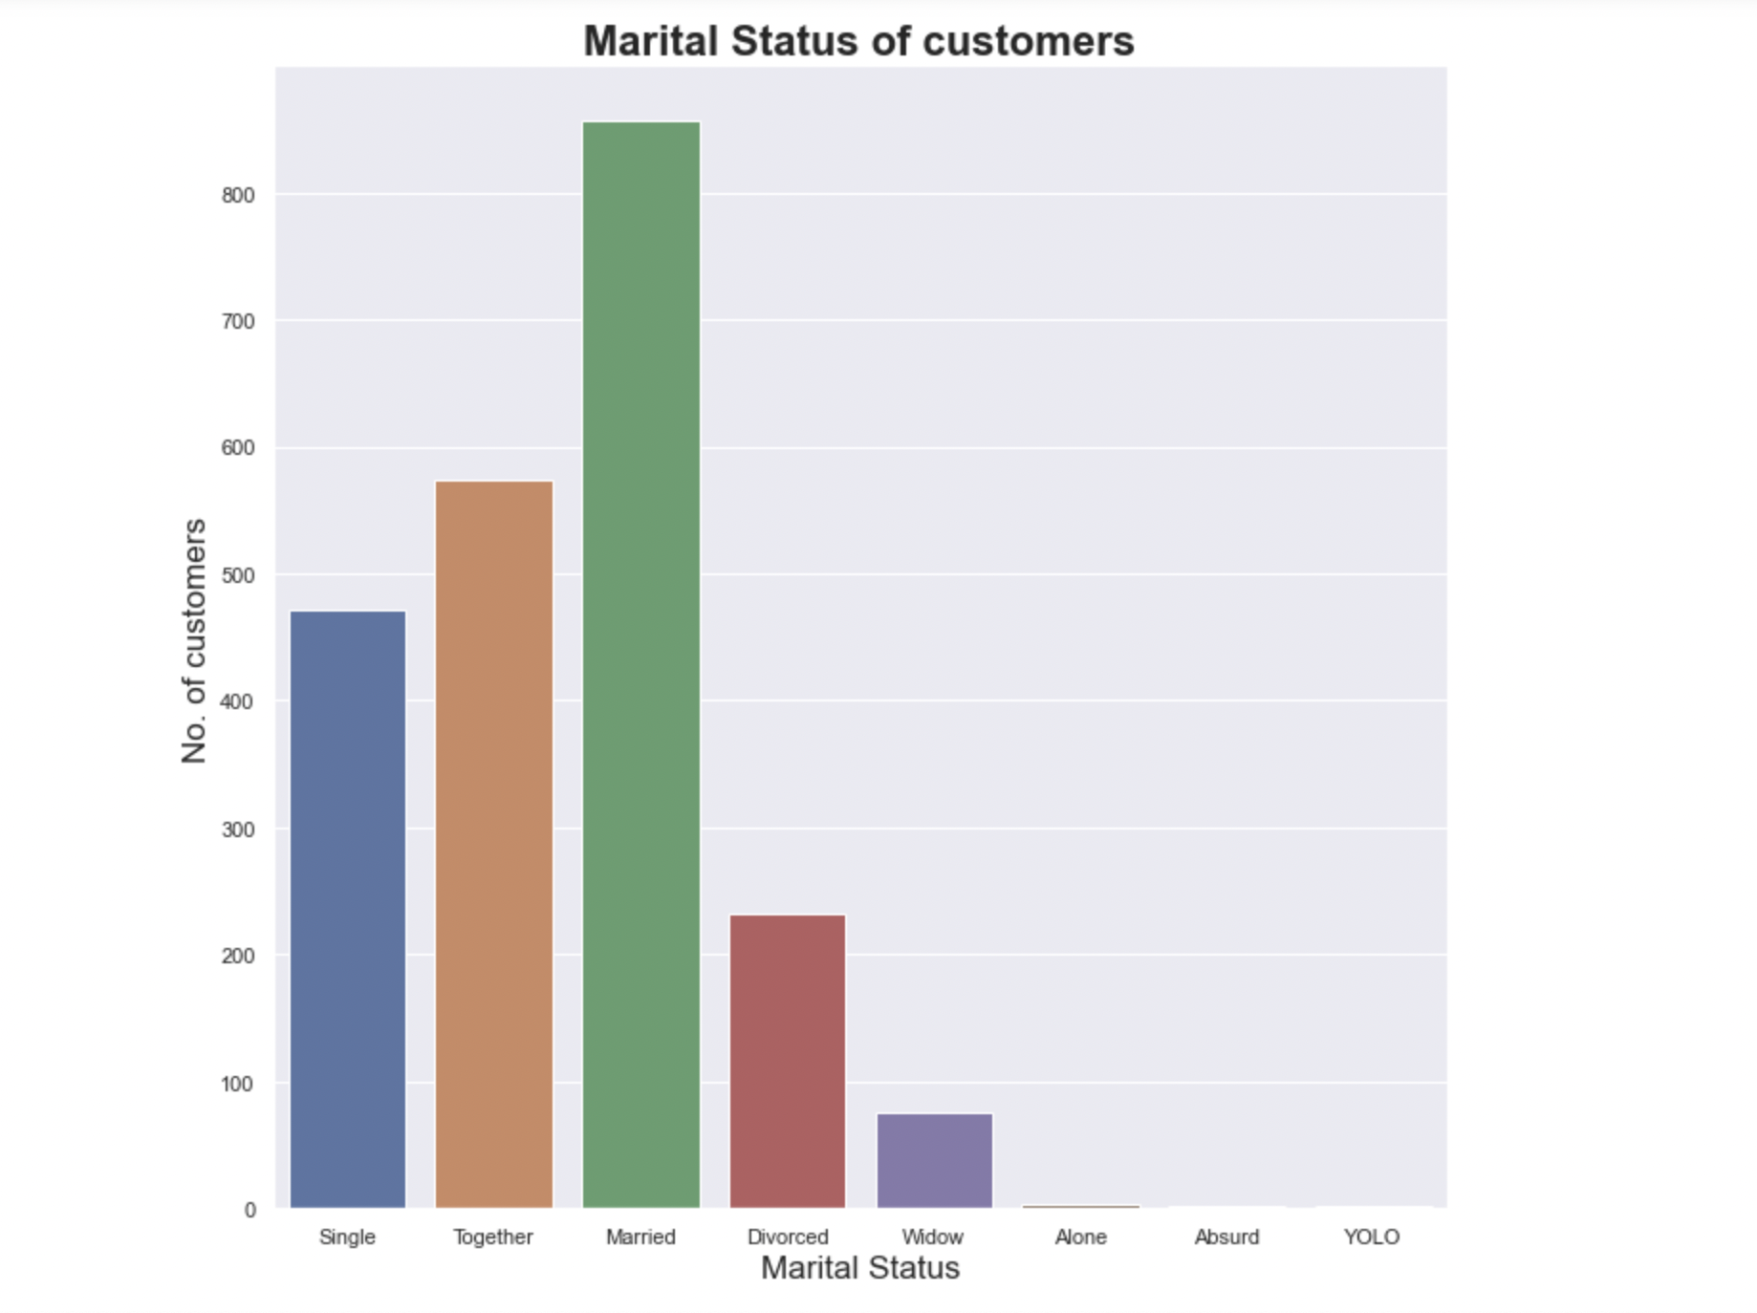

Slide 9
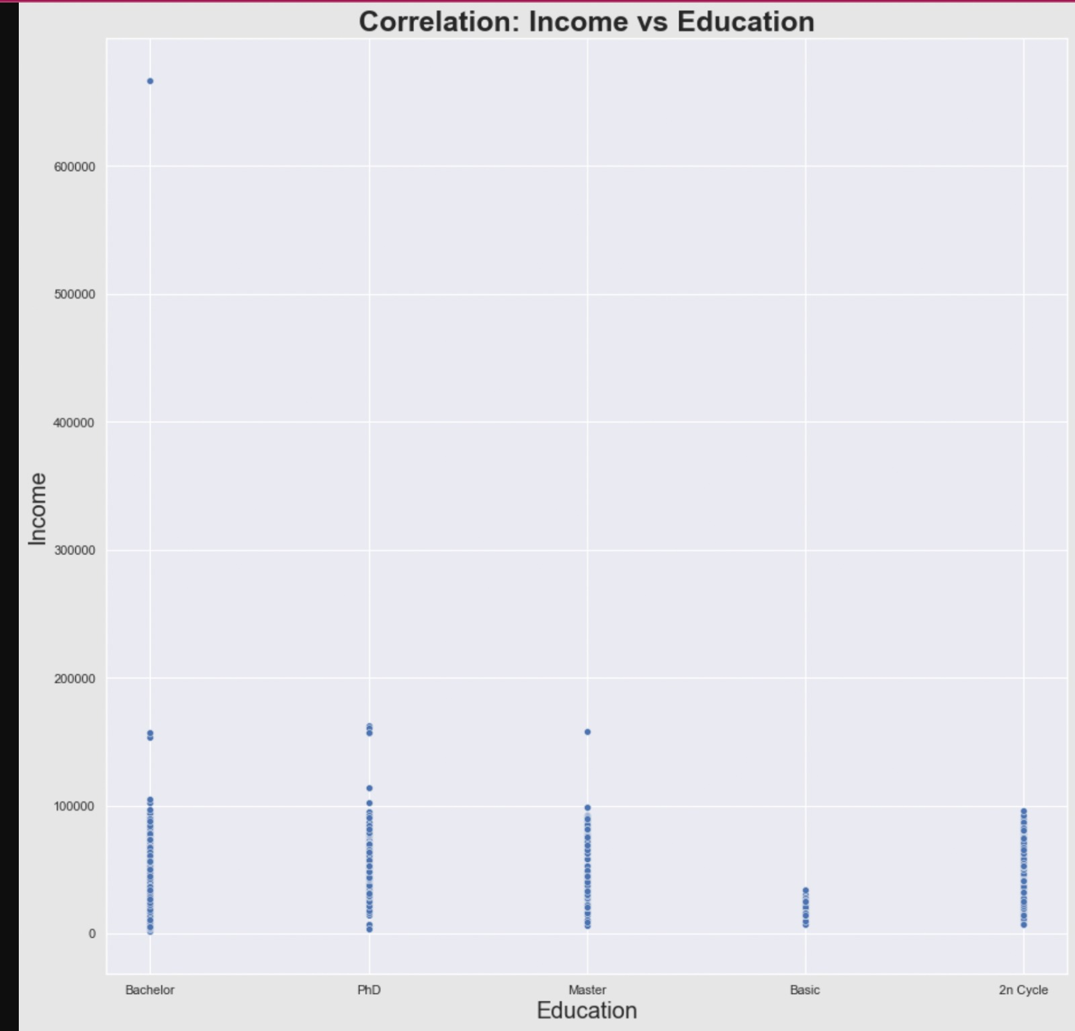
Customers with basic education background earn least, while those with 2n Cycle degree experience increase in income as they get older (or gain more experience).

Slide 10
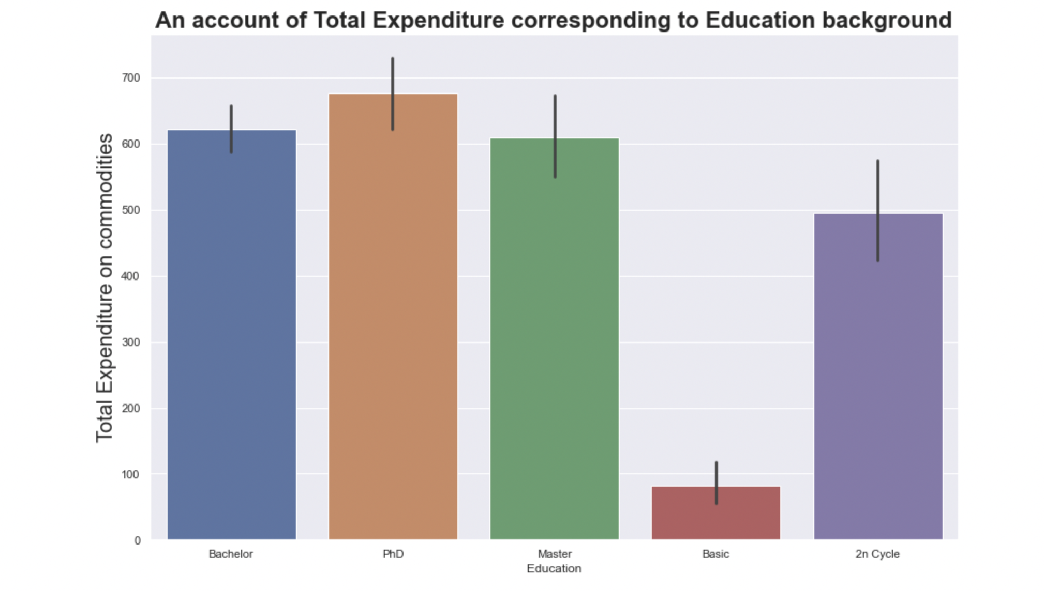
This could be due to the fact that 2n cycle has customers from lower age group (hence lesser material requirement) in comparison to Graduation, PhD and master’s students.
Customers with PhD background have higher spending pattern over others. Customers with basic educational background spend the least. Customers with higher educational background earn higher and hence tend to spend higher. They have higher spending capability. Ironically 2ncycle is defying this hypothesis with total buy below graduation, PhD, and Master’s.

Slide 11
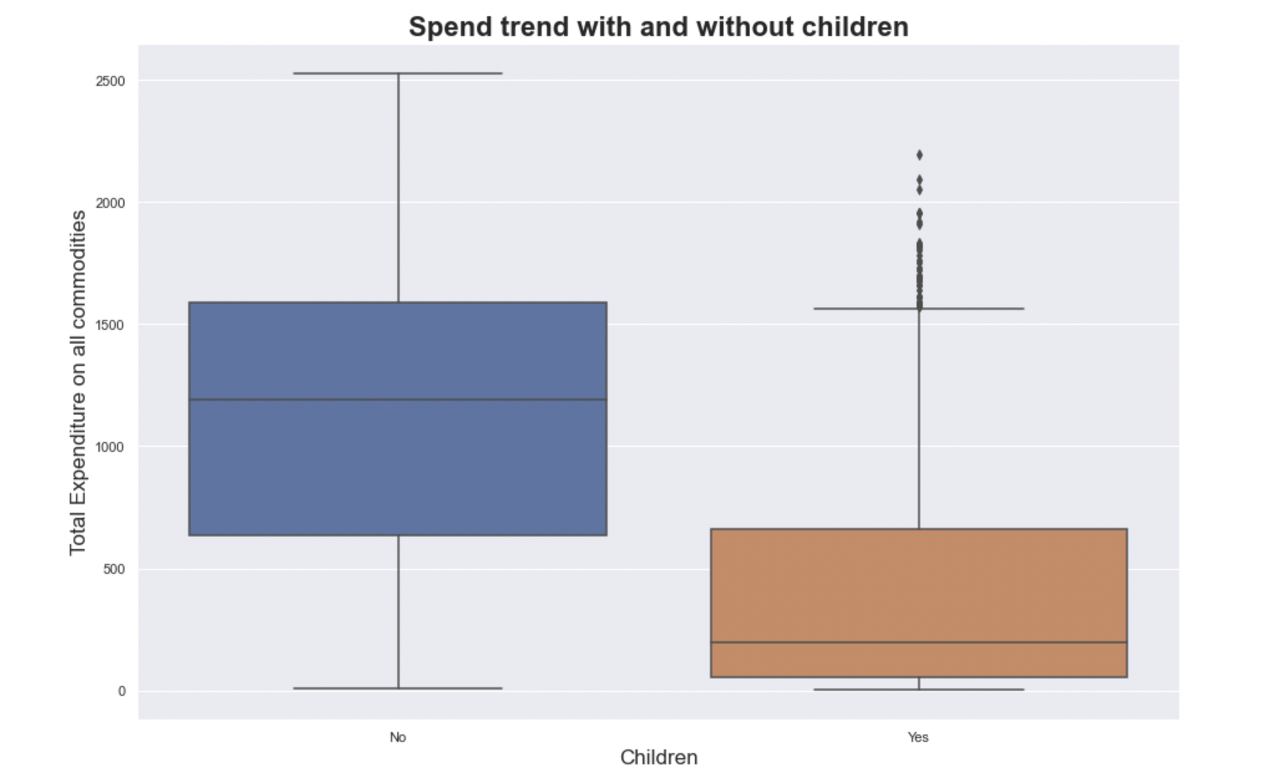
Customers with no children have higher variation in spend trend and customers with children have outliers but usually spend lower than the customers who have no children.

Slide 12
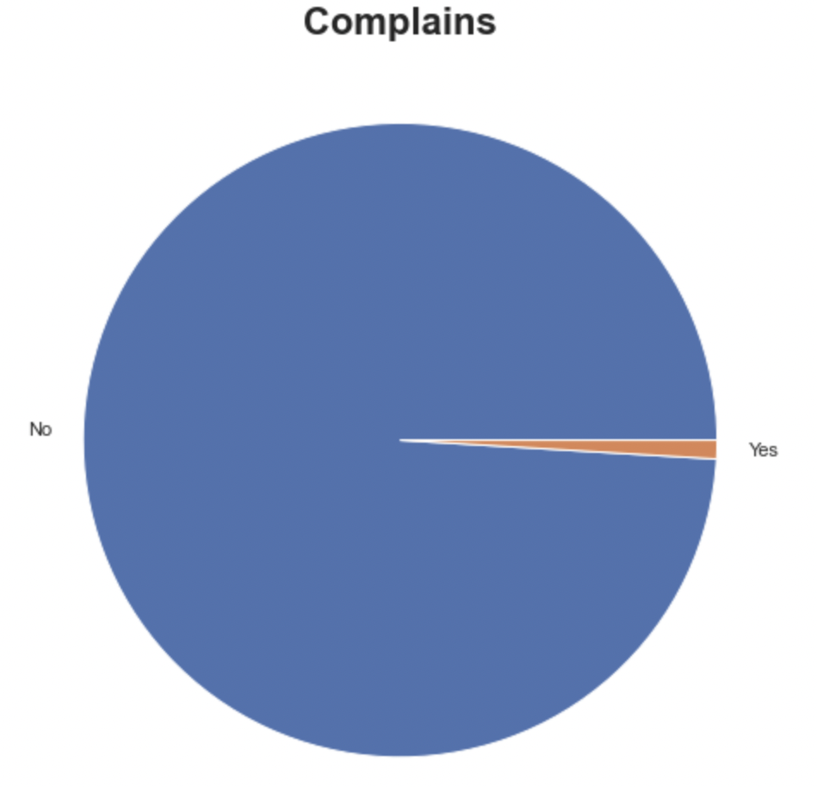
This company is doing a great job in maintaining customer satisfaction. There are hardly any complains

Slide 13
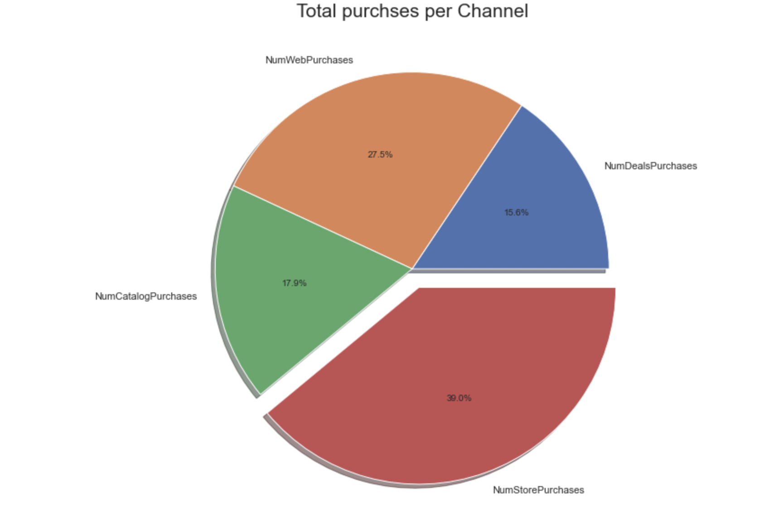
Customers of this company usually prefer to make store purchases followed by web purchases. Customers don’t purchase on discount much.

Slide 14
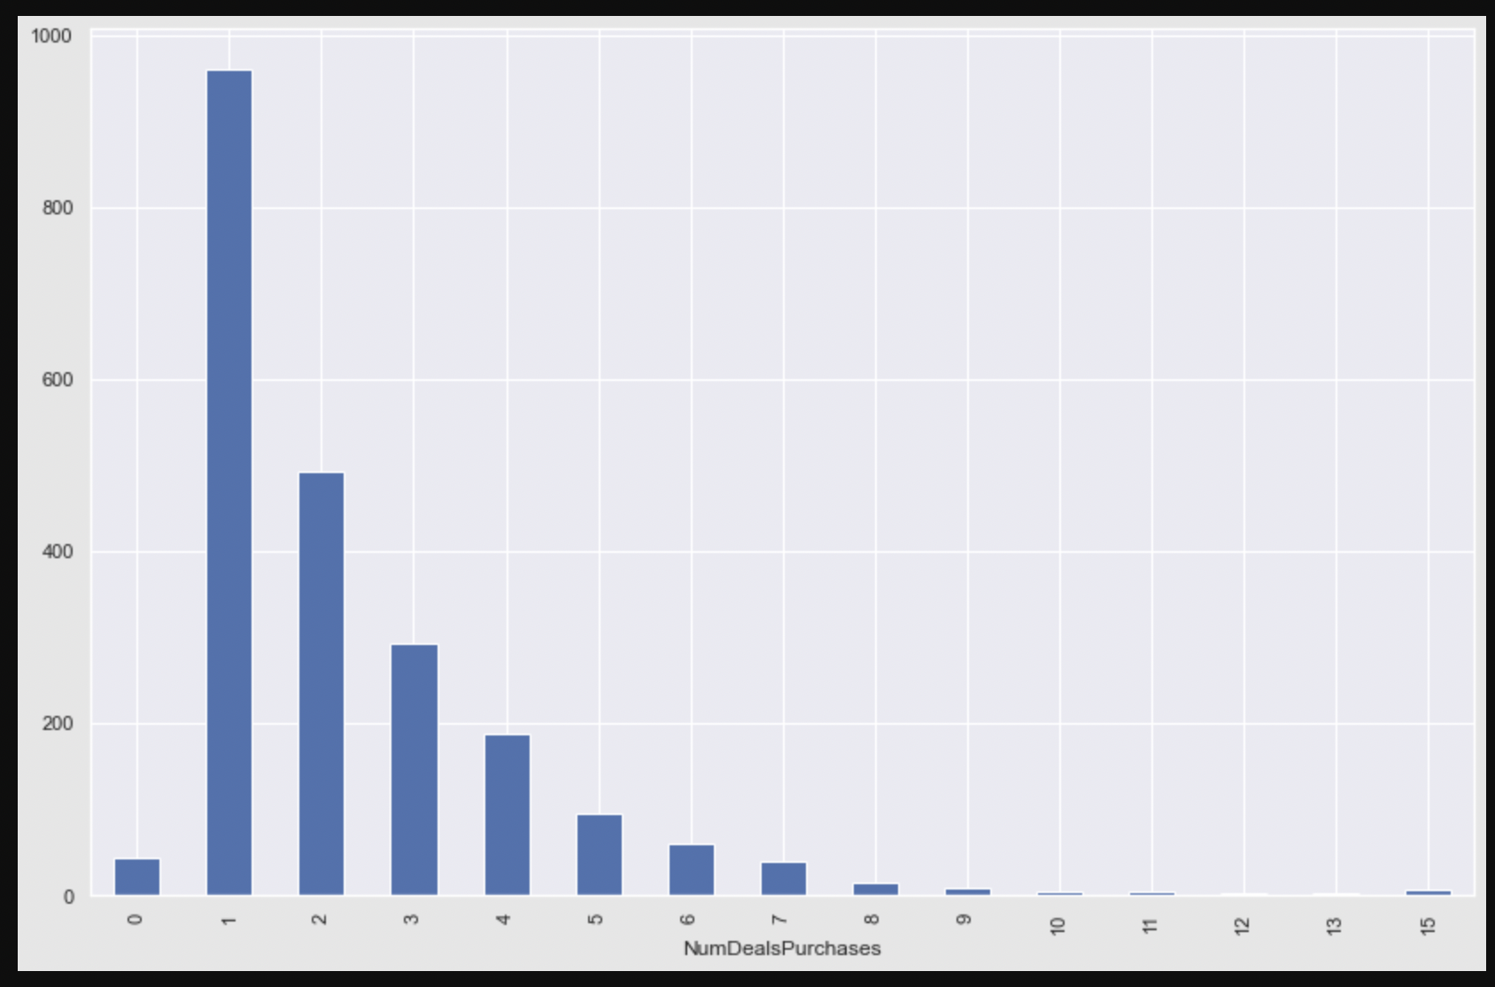
The above count plot clearly shows that large number of customer use at max one discount. Discounts used by a single customer is dropping down from 2 discounts to 10 discounts. There are hardly any customer is using 15 discounts.

Slide 15
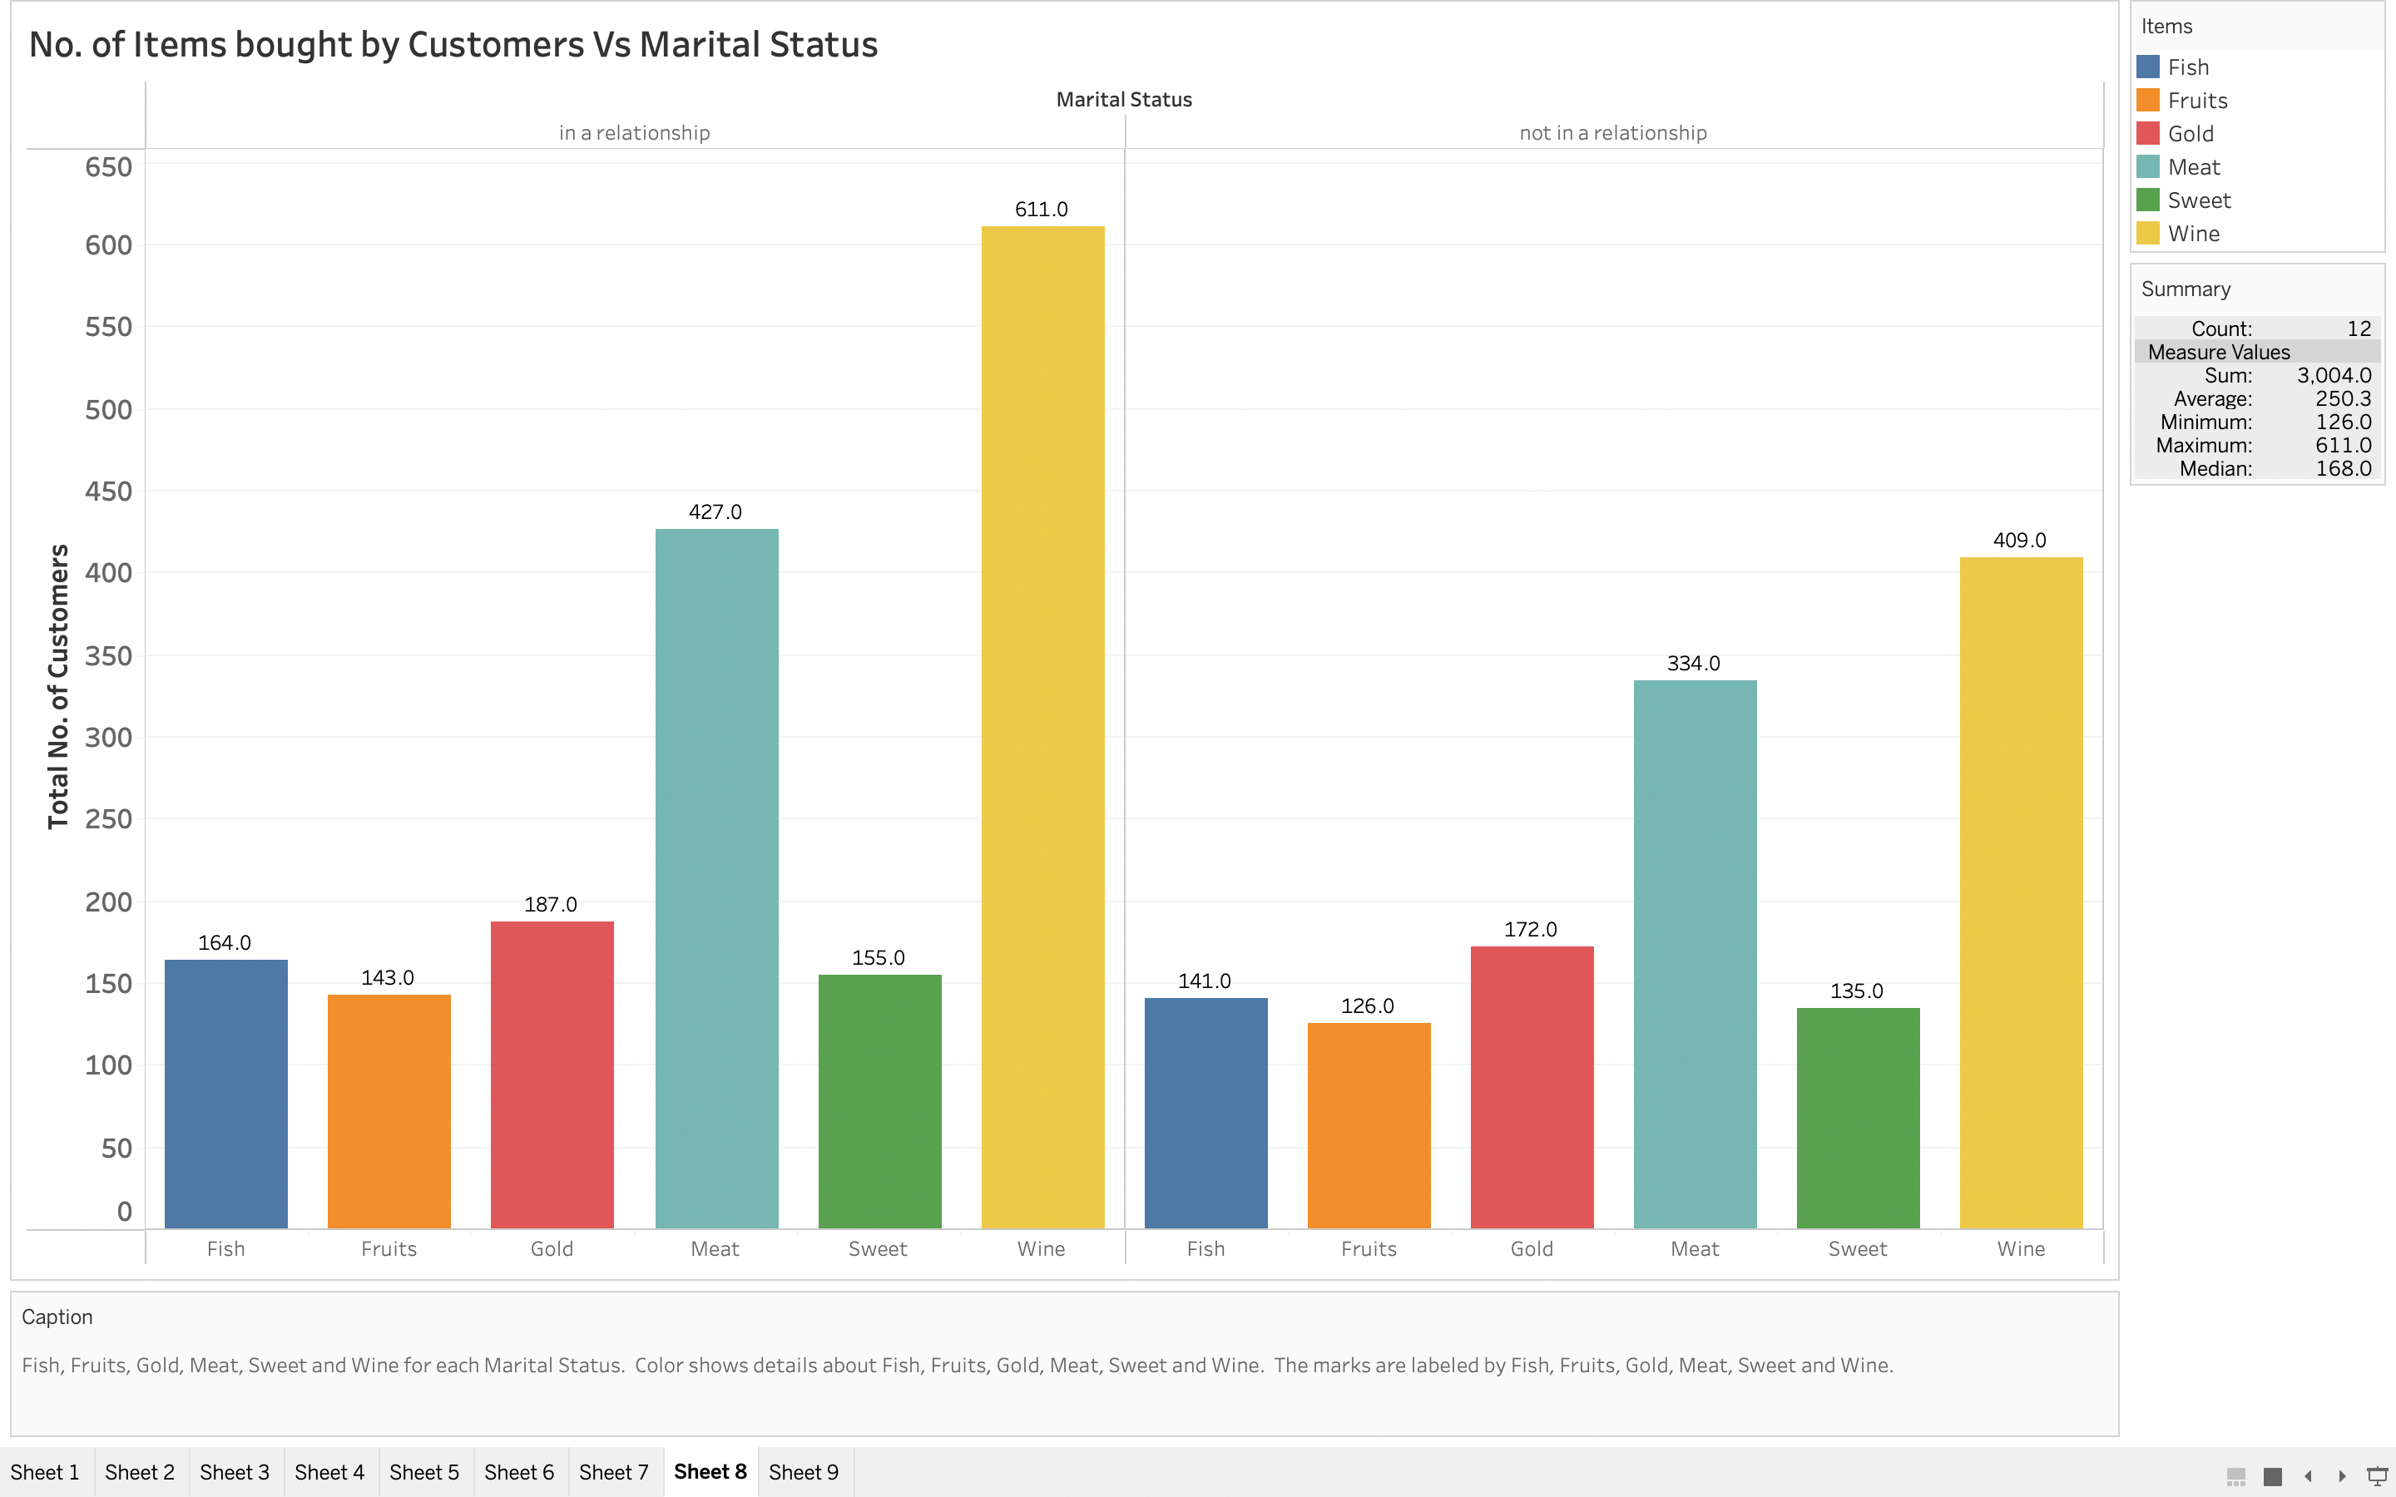
We notice that customers who are in relationship buy more ‘wine’ than the customers who aren’t in a relationship which infers that ,since majority of the customers of this company are middle age and in a relationship, we can say that this company gains more revenue from wine and should keep the stock of wine up to the mark.

Slide 16
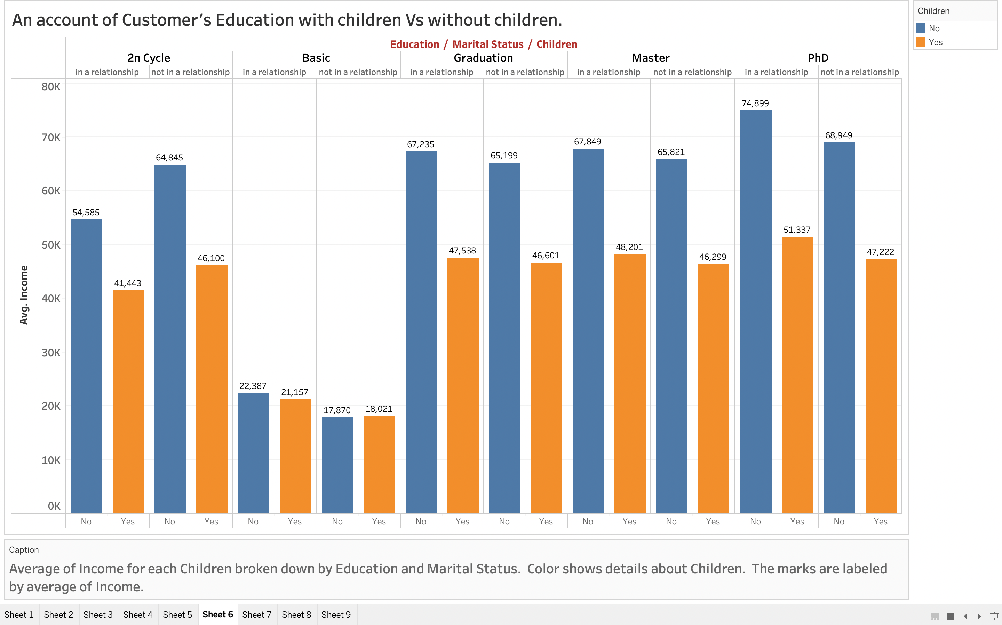
We analyze from this graph that customers who don’t have children are earning more than customers who have children, irrespective of their education background.

Slide 17
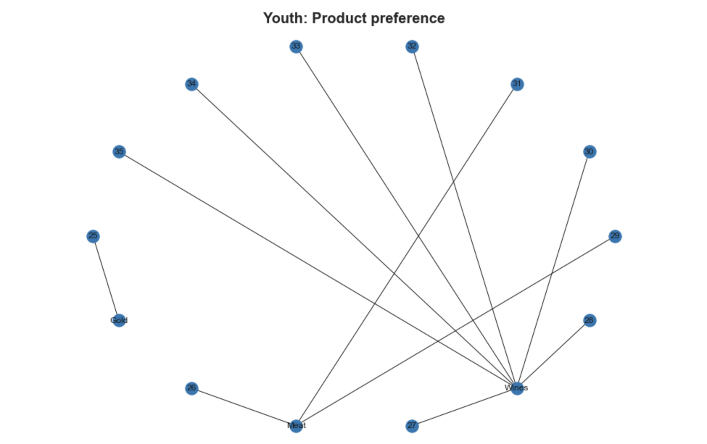
Network graph: Youth: Product preferences

Slide 18
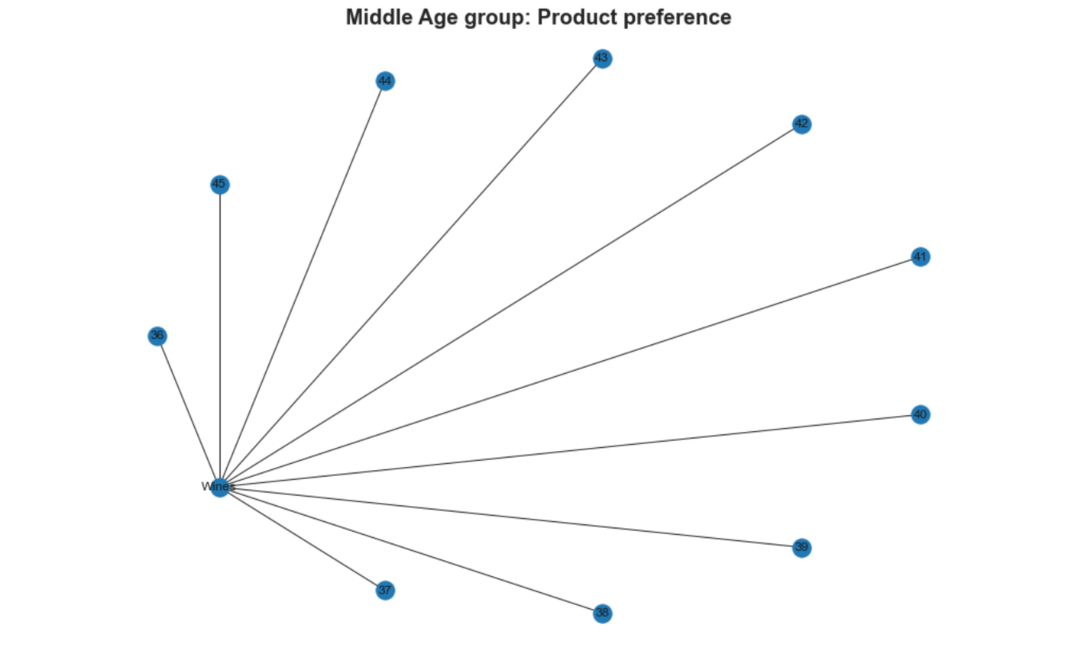
Network graph: Middle Age: Product preferences

Slide 19
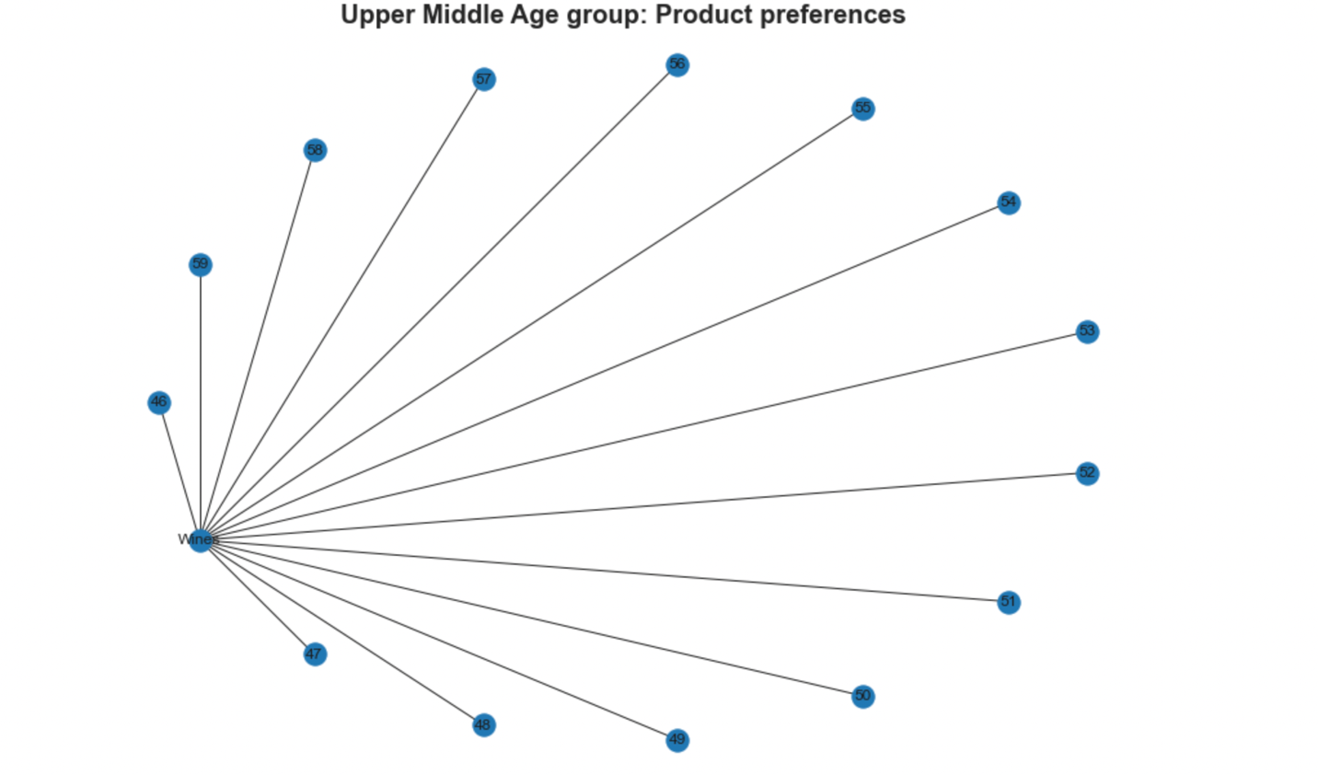
Network graph: Upper-Middle Age: product preferences

Slide 20
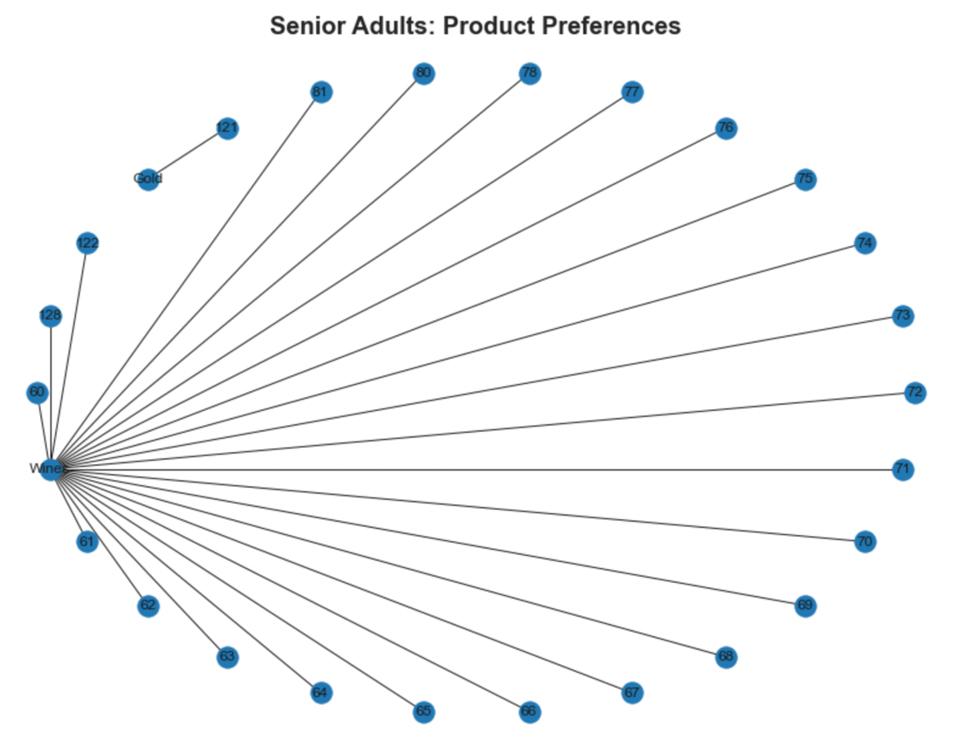
Network graph: Senior Adult: product preference

Slide 21
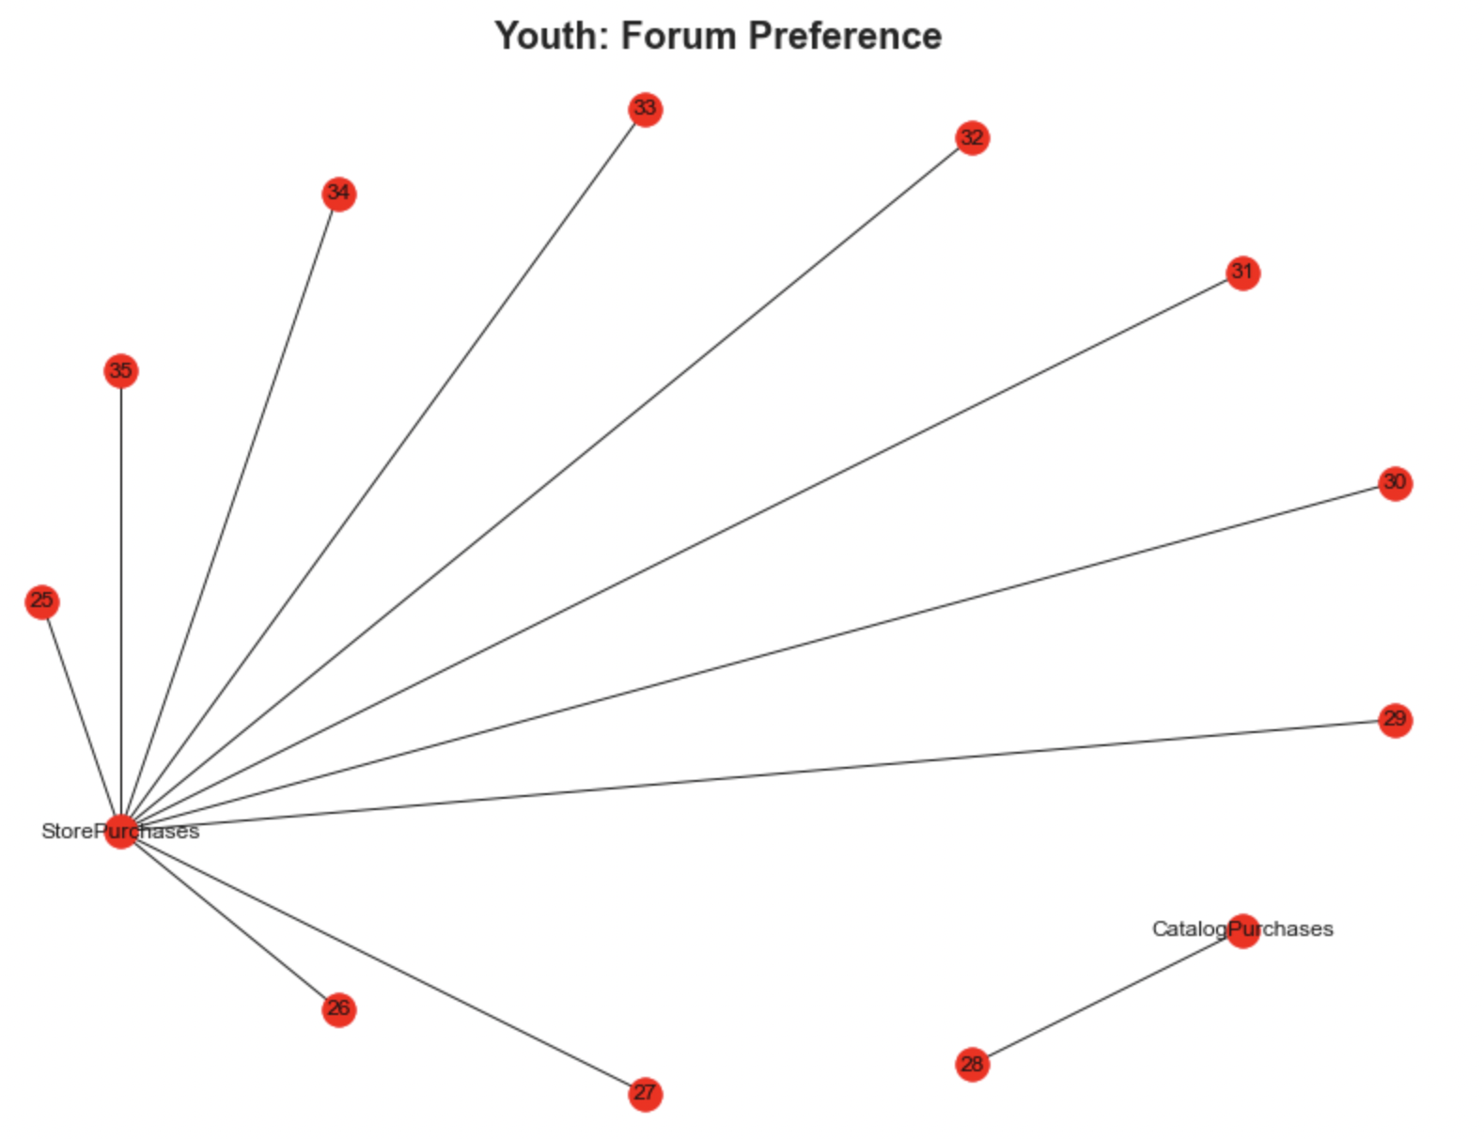
Network graph: Youth: Forum preferences

Slide 22
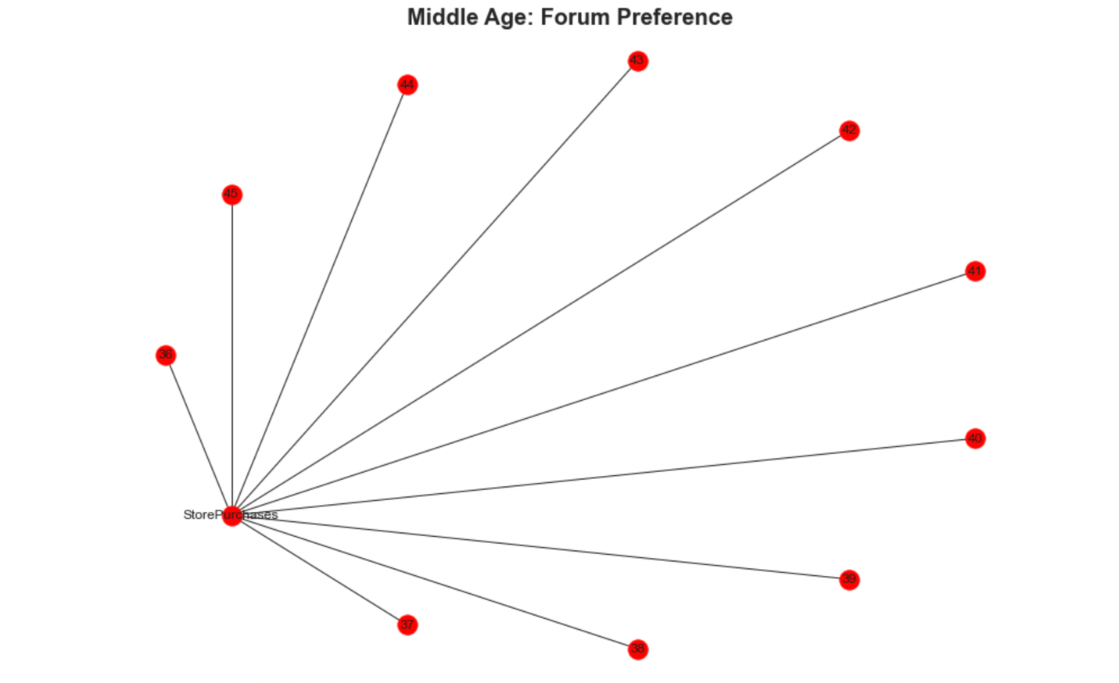
Network graph: Middle Age : forum Prefrences

Slide 23
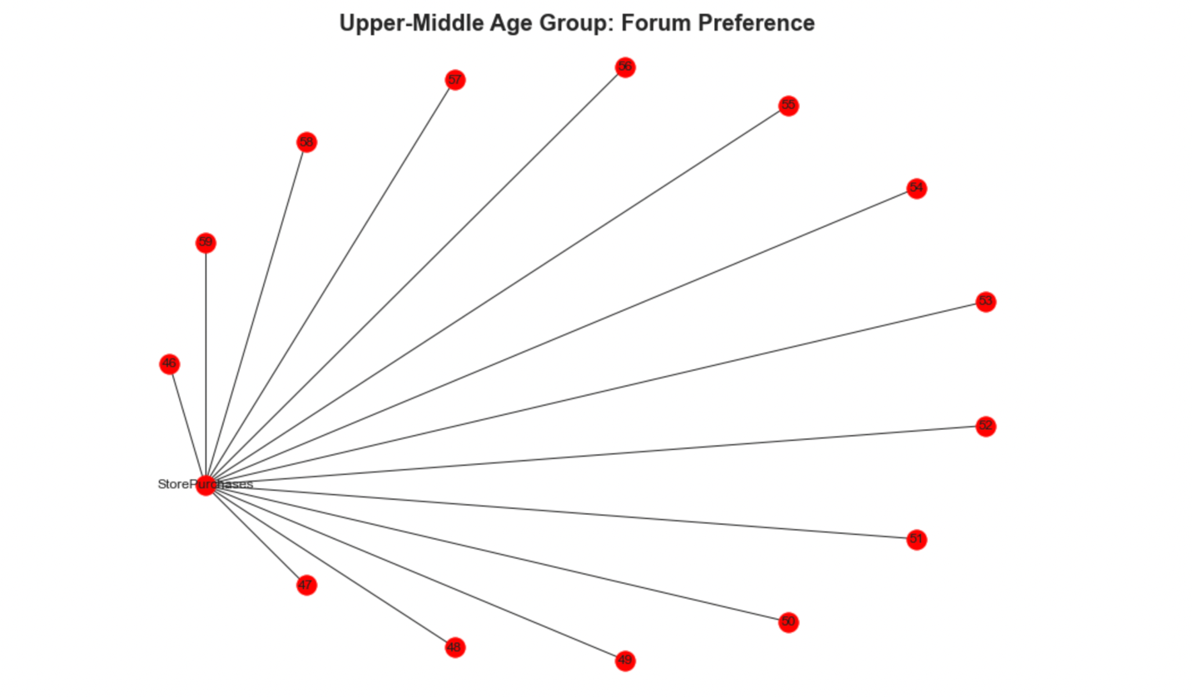
Upper-Middle Age Group: forum Preference

Slide 24
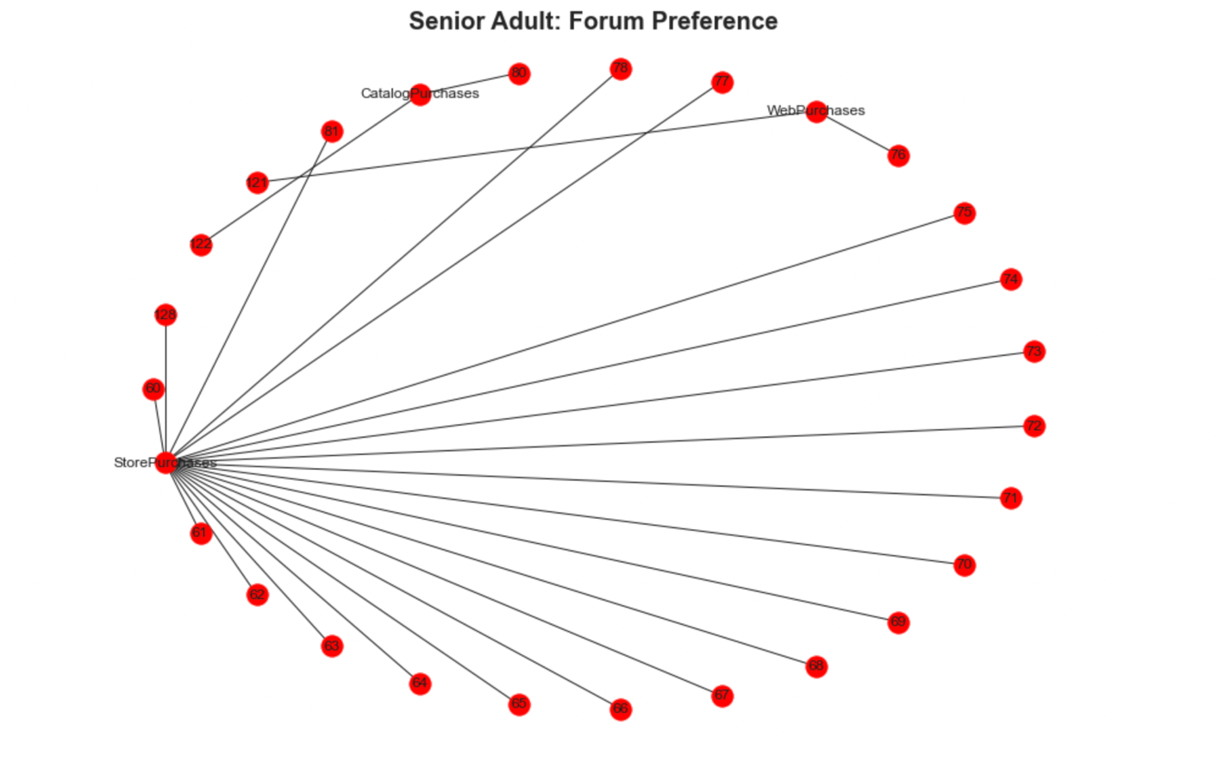
Network graph: Senior Adult: forum Preferences

Slide 25
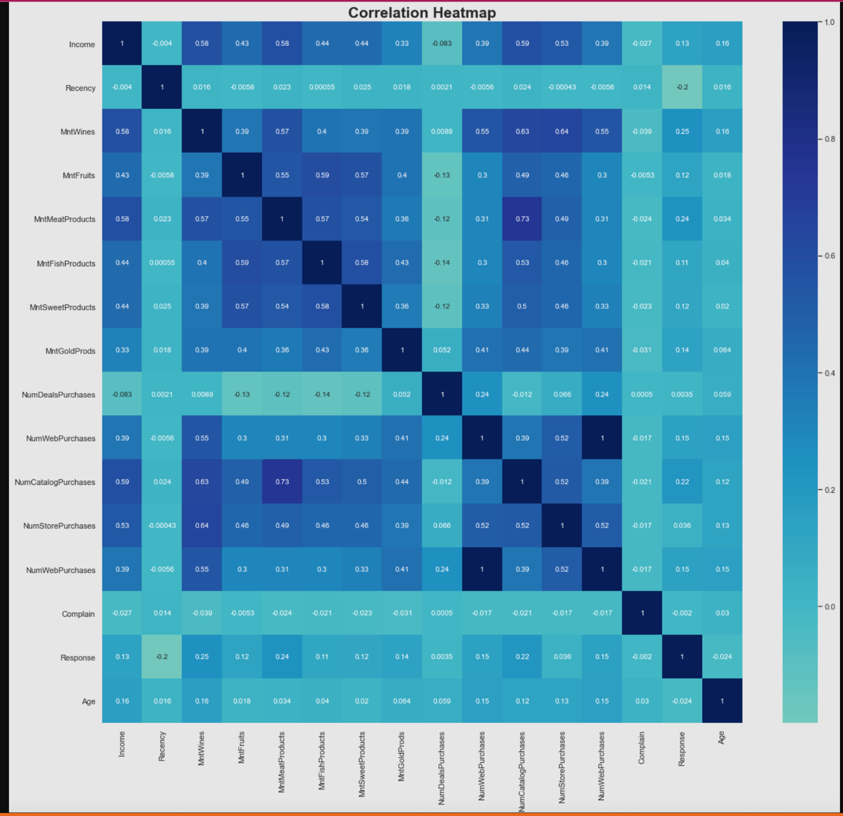

Slide 26
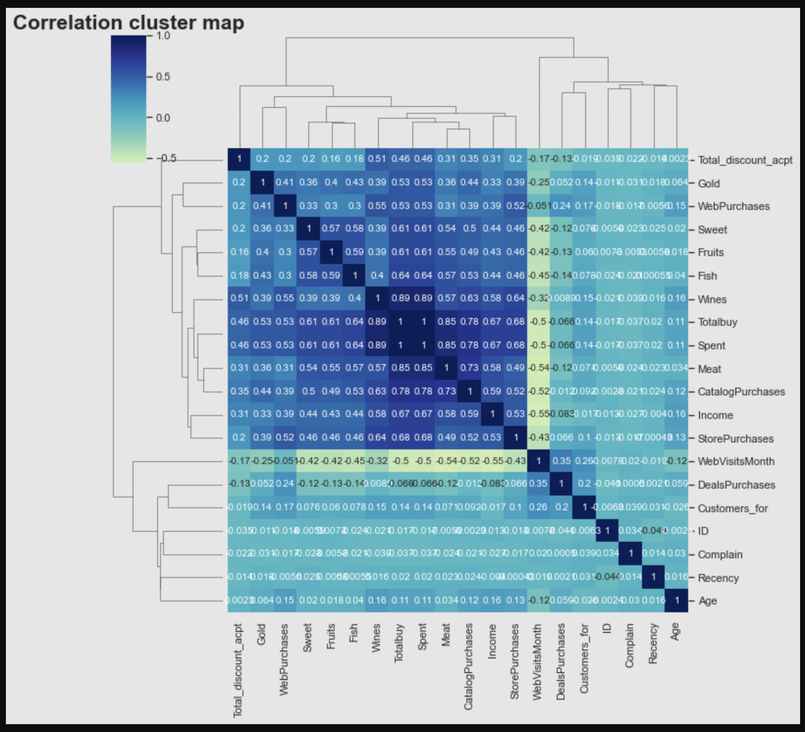
There is no multicollinearity (Correlation value>0.7). So, we cannot drop any column henceforth.

Slide 27
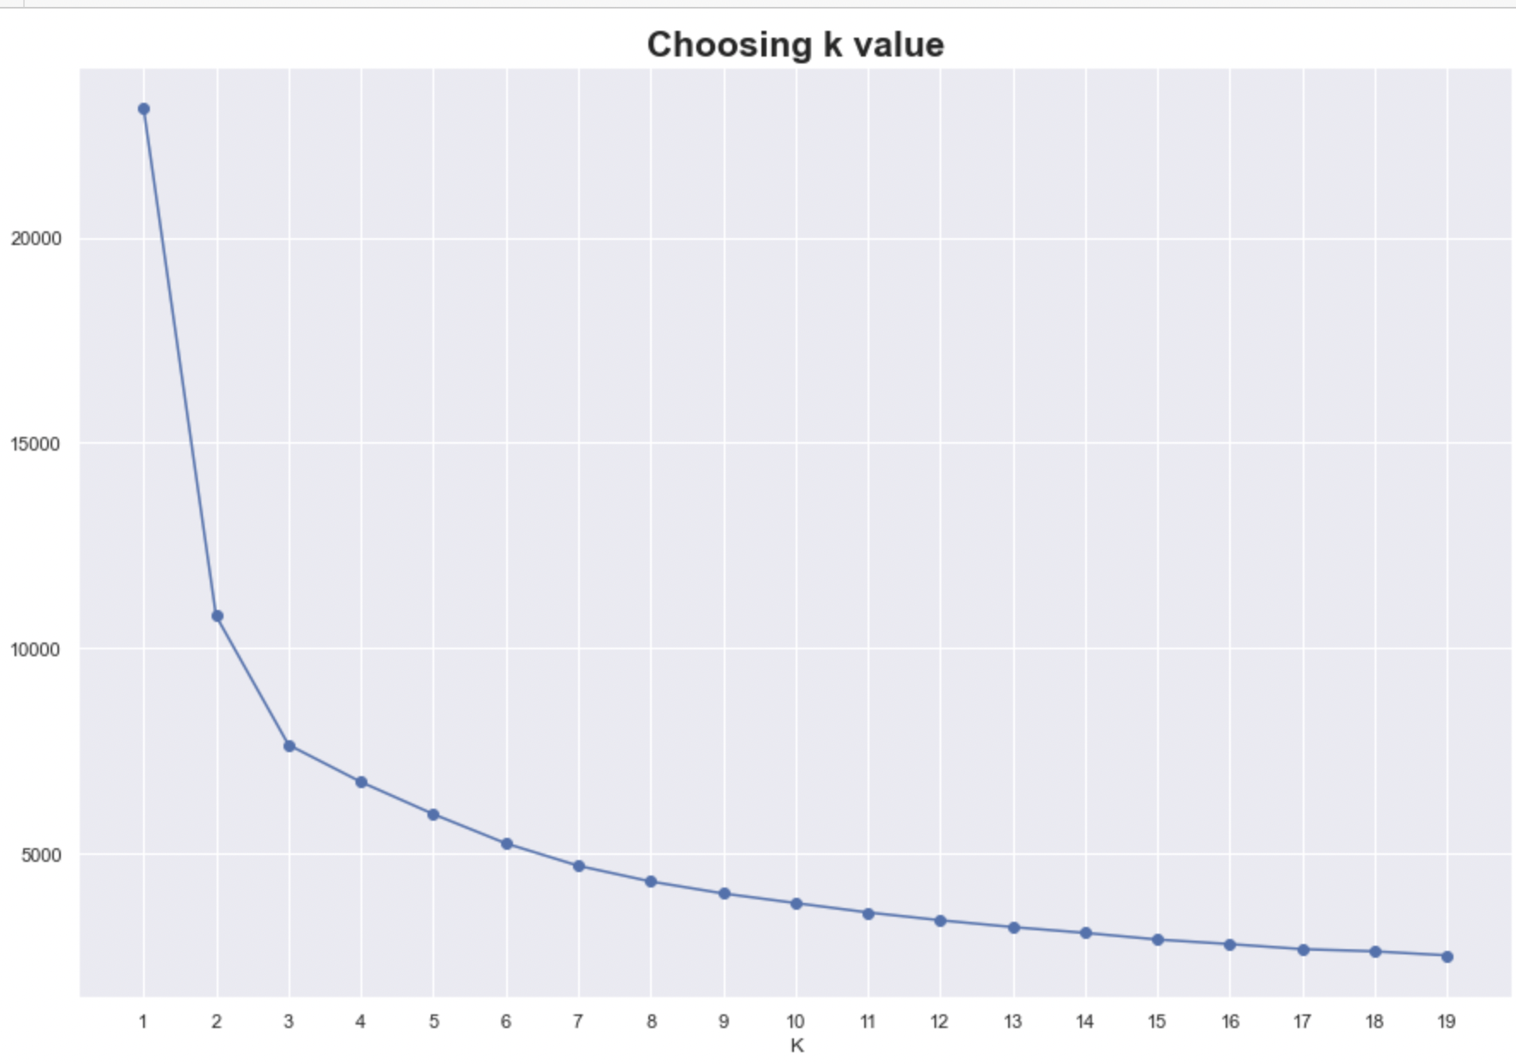
Choosing k value in K-Means
We used inertia to choose our k value.
Ideal k value is the one with lower k value and inertia

Slide 28
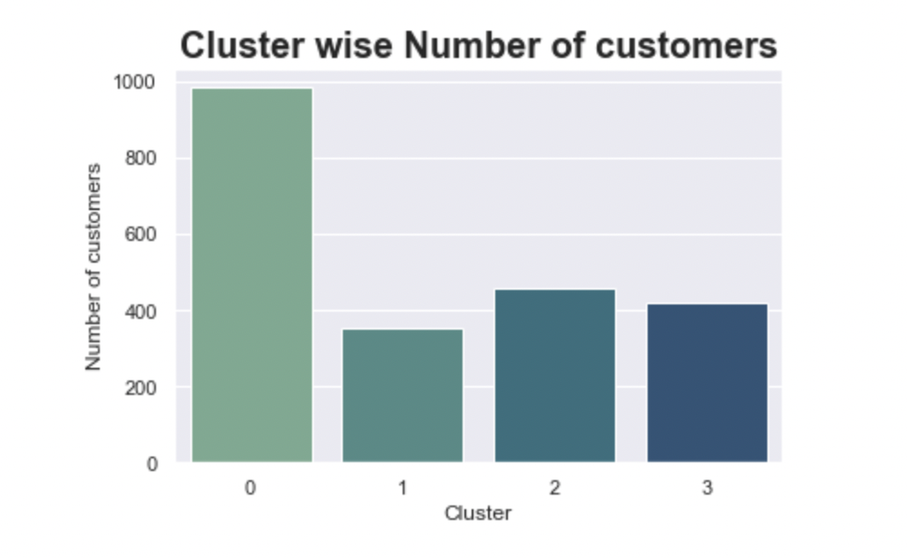
Count Plot: Number of Customers in each cluster

Slide 29
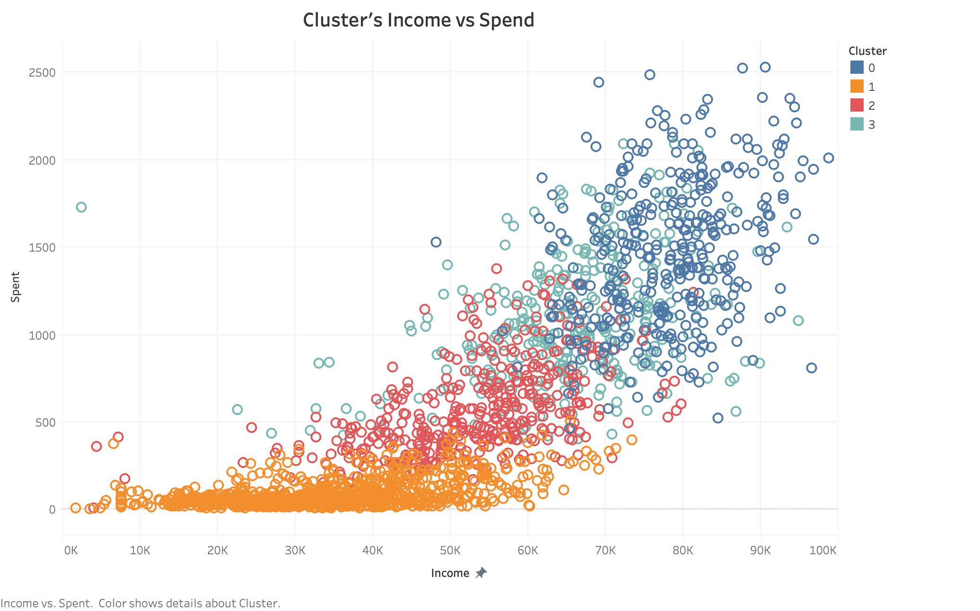
Scatter Plot: Income Spend Trend among clusters

Slide 30
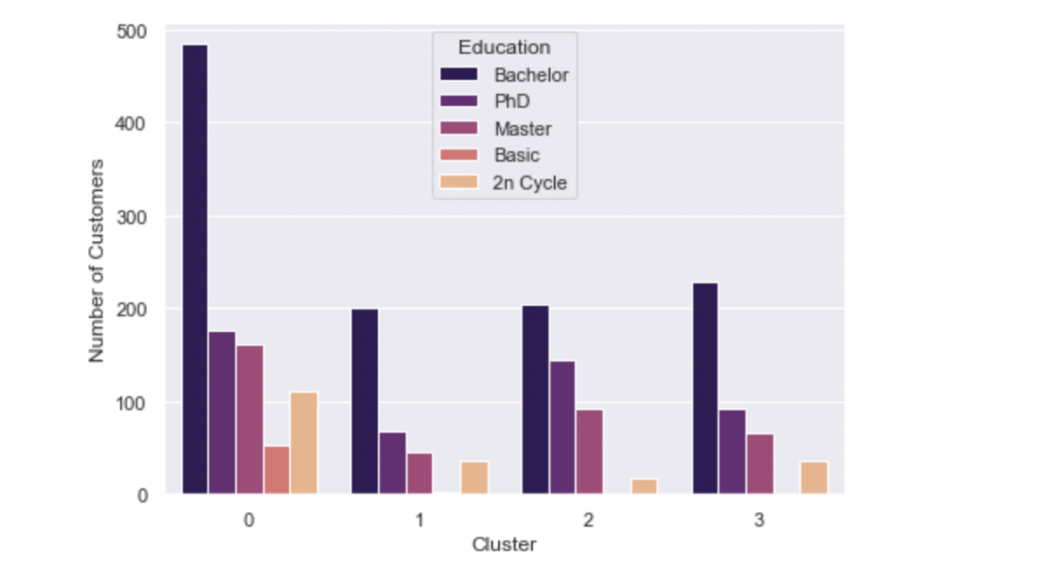
Pair Bar chart: Education categorization in clusters

Slide 31
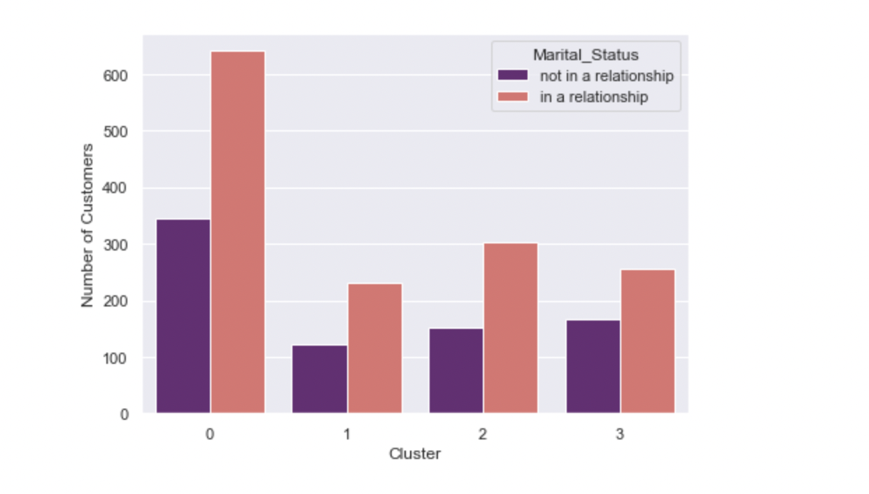
Pair bar Chart: Marital Status in Clusters

Slide 32
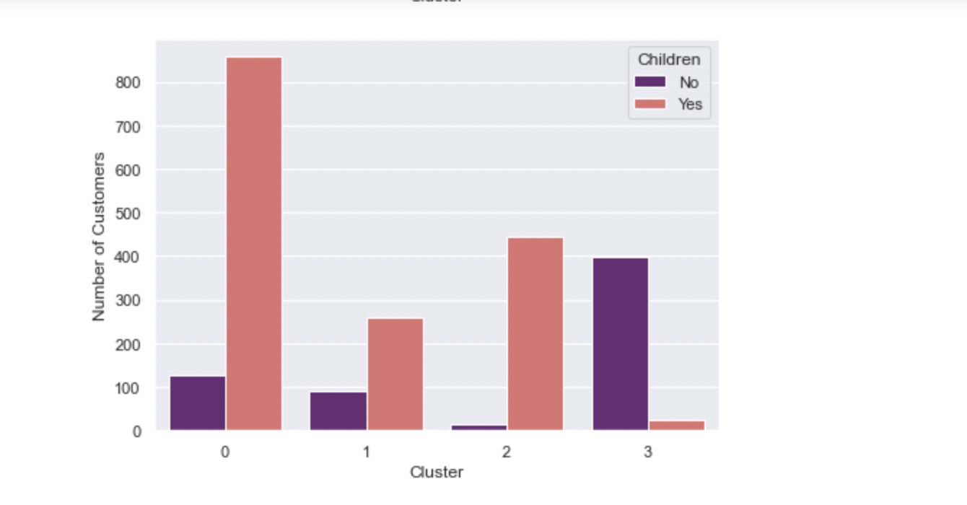
Pair Bar Chart: Clusters categorized by customer numbers with and without children

Slide 33
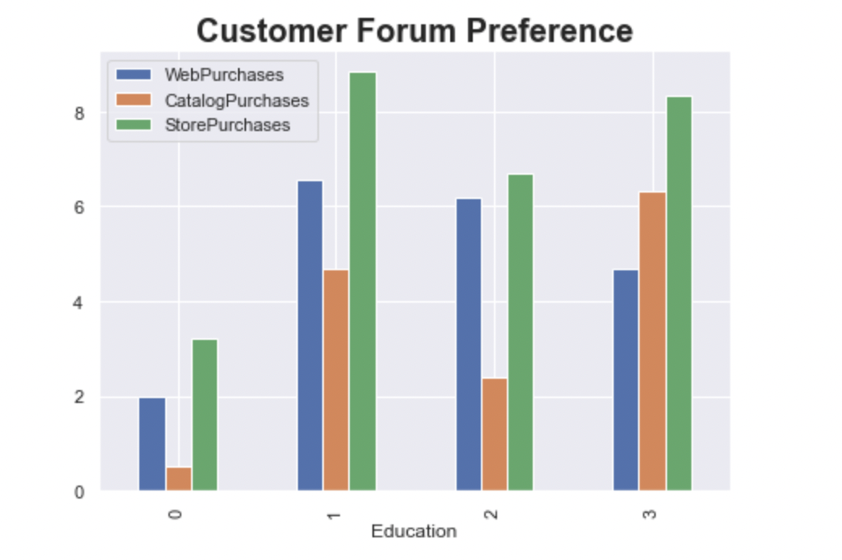
Pair Bar Chart: Cluster wise purchase Forums

Slide 34
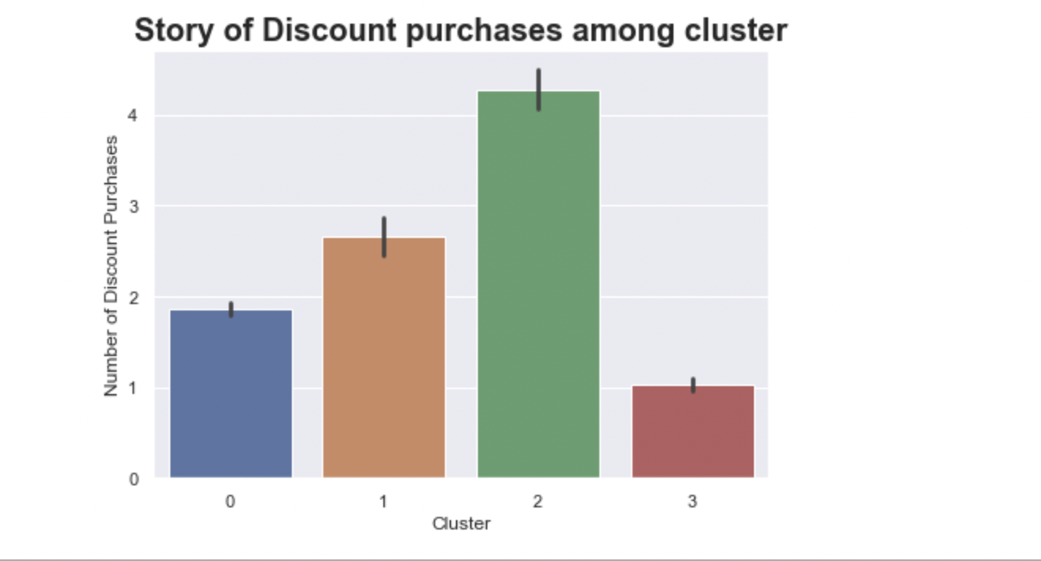

Slide 35
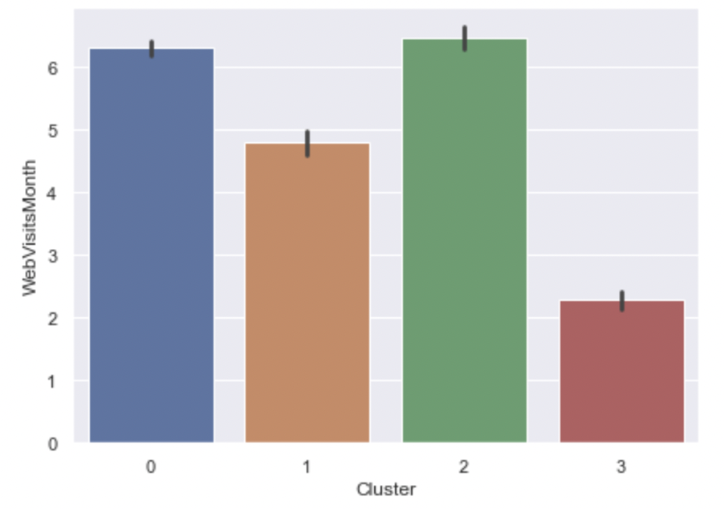
Bar Chart: Web Visit Statistics in clusters

Slide 36
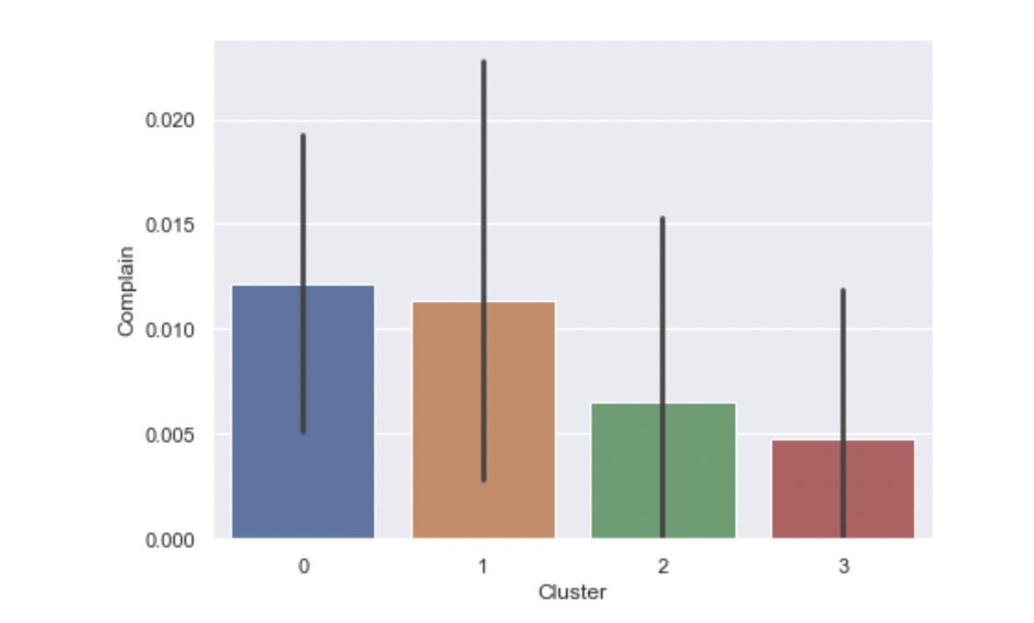
Bar Chart: Complaining Customers

Slide 37
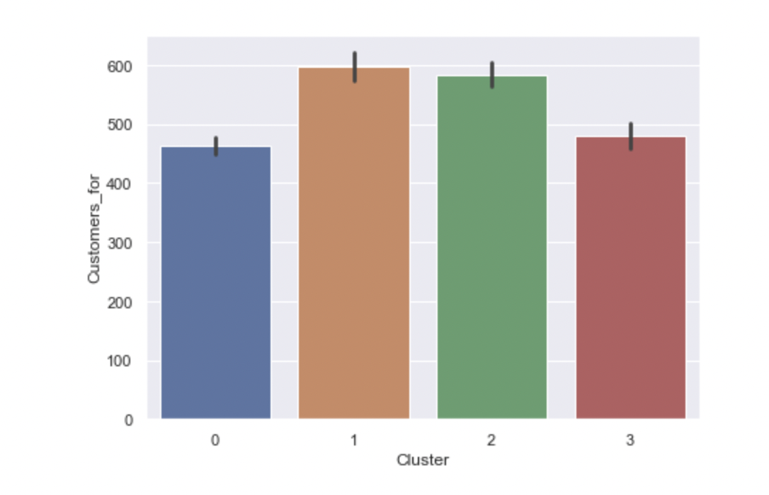
Bar Chart: Customer Loyalty

Slide 38
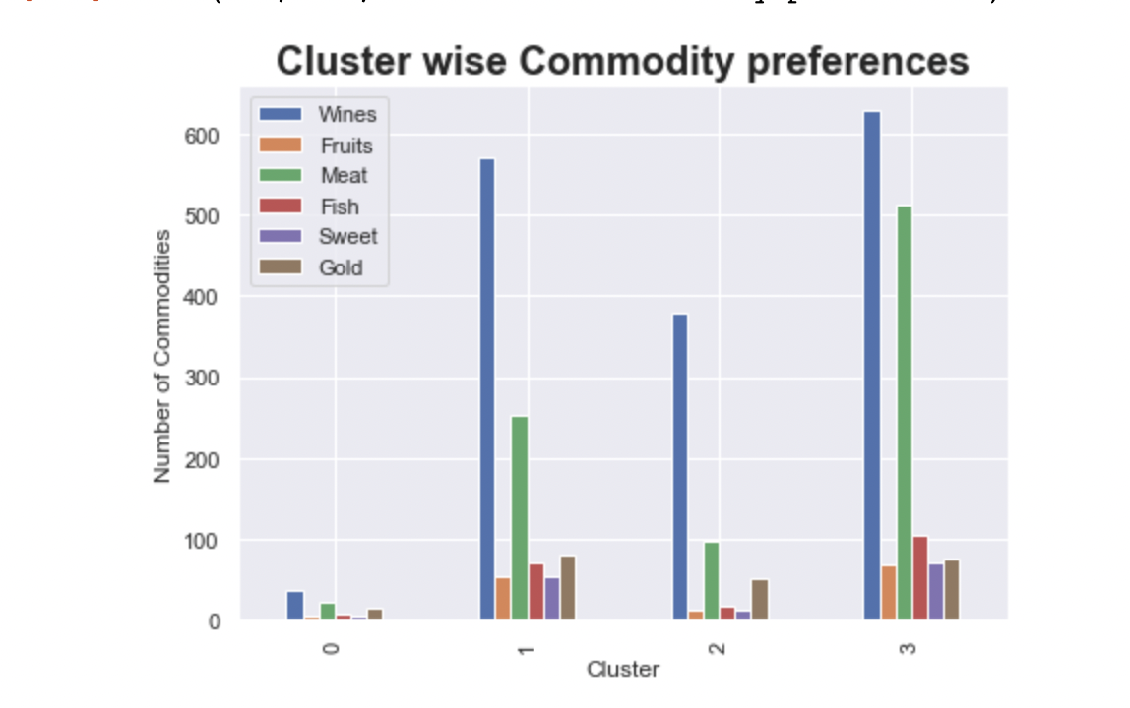
Pair Bar Chart: Cluster wise commodity preferences

Slide 39
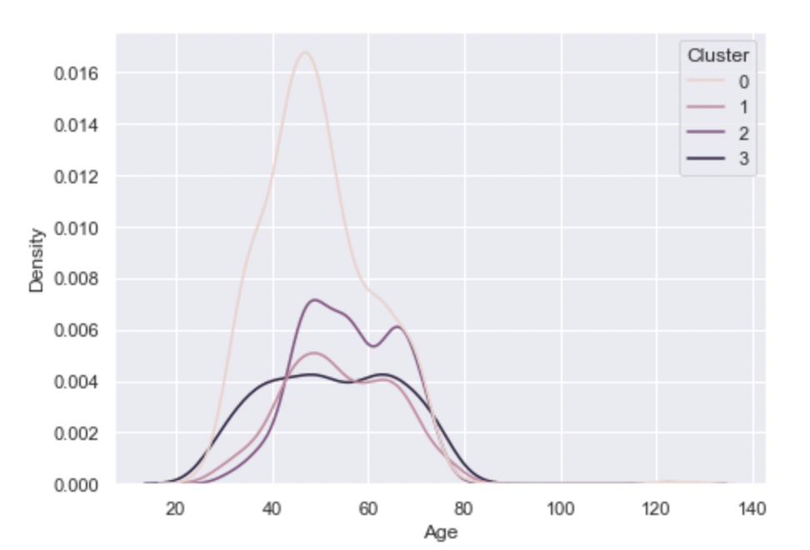
Density Plot: Age of Cluster

Slide 40

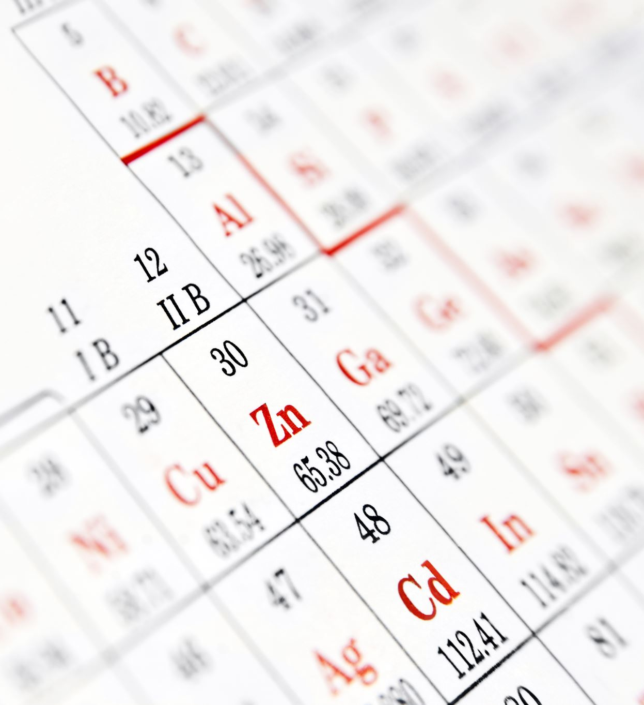

Inference
The Cluster 0
1. Cluster 0 covers large chunk of customers for this company.
2. It is observed that cluster 0 are moderate to high income, moderate to high spend group
3. Cluster 0 have highest numbers of those in relationship and have children and have highest bachelor degree holders
4. They general purchase instore.
5. Cluster 2 followed by cluster 0 make the highest company website hits.
6. They purchase significantly less in number and don’t have wide range of preferences.
7. Since, customer 0 are high in number they complain a lot. They purchase less. Probably cluster 0 has less customer satisfaction. Overall, this company gives better customer satisfaction as customers complain less

Slide 41
Cluster 3
Highest but 1 buy and highest but 1 spend category.
Wide range of product preferences. –prefer variety-Making them a potential area for various product line sale-The experimentative group
They visit the company frequently for products.
They are least complainers and don’t wait for discounts.
Cluster 1
They are classic example of experimentative group. They have wide range of product preferences
They have low income and spend relatively low.
They can be targeted for web purchases (ecomerce–potential forum)

Slide 42
Observation
All the clusters make highest instore purchases and consume wine in significantly large amounts
Cluster 1 followed by cluster 3 are highest store purchasers
Cluster 2 does a lot of discount purchasing
All of them frequent to the company for products..
Cluster 1 and 2 have been longer with the company.
6. Cluster 3 and Cluster 1 have wide range product preferences.
7. Cluster 1 and 2 can be targeted for web purchase.

Slide 43
Future Scope of Business
Potential Target group: Cluster 0- because they are highest in number with higher spend capacity. They are also the highest complainers, have relatively younger relationship with company.
Potential Forum: Web. This company should explore e-commerce- Heavy save on company’s overheads.
Cluster 1 has high appetite for wide range of products. Posturing should be aligned to satisfy cluster 1 (low income-spend). They can be the source of review for wide range of products. -Test group
Cluster 3 the second highest income-spend group is one of the potential areas. They complain less, generally don’t have children, consume wine heavily.
Focus on cluster 0 (highly potential) and web purchases.

Slide 44

Future Scope of project
1. Some more information on geographic data would give an idea on customer satisfaction in different geographies and future scop of expansion
2. Huge data on psychographic data like if the customer is an Impulsive or planned buyers, customer’s Customer biases will give more insight on customer preferences and business as a whole.

